Slide 1
GameCo Presentation

Slide 2
Agenda
Introduction
Changes in Geographical Market Share
Geographic Sales Percentage Split
Revised Understanding
Recommendation
Summary
Questions

Slide 3
Introduction
GameCo.’s current assumption of their sales per geographic region is that they have remained constant over the period in review.

Slide 4
Changes in Geographical Market Share
From 1980 to the end of 1994, game sales hovered below the 50 million mark.
From 1995 game sales in North America and Europe experienced a significant increase up until 2008. Japans sales and that of the other reasons experienced steady growth, however, not as much as the aforementioned regions.
From 2008 all markets have experienced a decline with North America experiencing the sharpest decline out of all of the regions.
Figure 1.1: Historical Game Sales by Geographical Regionfrom 1980 - 2020

Slide 5
Geographic Sales Percentage Split
From 1980 to the end of 1994, North America accounted for the majority of sales, followed by Japan, Europe and then the other regions.
From 1995 North America’s sales continued to dominate market share with Europe’s market share seeing steady growth. Japan on the other hand would see a steady decline in their market share up until 2011.
From 2008 there was a general decline in sales with North America experiencing the largest decline.
From 2016, Europe surpassed North America as the leading sales region, with Japan lagging behind in third place and the Other regions remaining last.
Figure 1.2: Historical Chart of the Percentage of Geographical Sales of Global Sales from 1980 - 2020

Slide 6
Revised Understanding
GameCo initially assumed that their sales per geographic region remained the same. However, insights from the analysis highlighted that this is not the case.
However, the analysis shed some insight into changing market share figures with Europe ending 2016 as the market leader, with North America second and Japan having slipped to third.

Slide 7

Recommendation
Table 1.1: Geographical Sales Per Region Per Platform from 2014 - 2016
Based on the change in market share, I would suggest a change in the advertising budget split between the different regions in line with the 2016 market share breakdown. I would advise marketing to sped 38% of the marketing budget on Europe, 32% on North America, 19% on Japan and 12% on the other regions.
There should be a concerted effort to increase the sales in North America as that is the region with the highest population. The aim should be to restore sales to the figures seen shortly before 2008.
Europe should also be paid special attention as that is a market that is growing rapidly and this is the time to capitalize on that growth.
Japan also needs to be included within the marketing strategy, however, it bares mentioning that the changes in platforms has also played an impact on the Japanese sales.

Slide 8
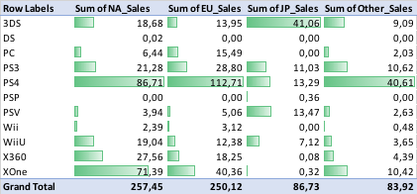
Recommendation Cont.
The marketing needs to be in line with the platforms that are being used and are currently the most popular.
Marketing that is geared to platforms that are no longer in use or that are not popular will lead to an inefficient use of funds and a significantly lower return on investment.
New platform releases should also be taken into consideration and included within the marketing budget, in line with the respective release dates. In Japan, more marketing needs to be done on the 3DS in comparison to North America, Europe and the Other regions.
In North America, Europe and the Other regions, marketing should be focused on the PlayStation 4 as that it the leading platform in those respective regions.
Table 1.2: Geographical Sales Per Region Per Platform from 2014 - 2016

Slide 9
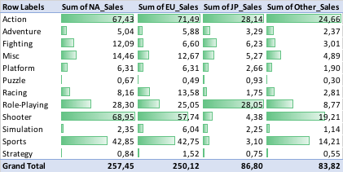
Recommendation Cont.
Another important factor to take into consideration is the popularity of the genres.
To obtain the best return on investment, the marketing budget needs to incorporate the most popular genres within their marketing campaigns.
There should be a focus on the Shooter, Action and Sports genres for North America.
The focus for Europe and Other regions should be on the Shooter, Action and Sports genre too.
The focus for Japan should be on the Action and Role-Playing genres.
Table 1.3: Geographical Sales Per Region Per Genre from 2014 - 2016

Slide 10
Summary
Based on the analysis it is evident that the geographical sales have changed over time. Using the analysis will greatly benefit the marketing team to allocate their budget in a way that will maximize the return on investment for the organization.
GameCo Final Presentation

Slide 11
Information is the oil of the 21st century, and analytics is the combustion engine.
“
”
Peter Sondergaad
GameCo Final Presentation

Slide 12
Questions?

